Slide 1
Greece February 2024 Primary school Novi Marof
Erasmus + Accreditation in school education

Slide 2
Sustainable development
Development that meets the needs of the present, without compromising the ability of future generations to meet their own needs."
The concept of sustainable development can be interpreted in many different ways, but at its core is an approach to development that looks to balance needs against an awareness of the environmental, social and economic limitations we face as a society.
The longer we pursue unsustainable development, the more frequent and severe its consequences are likely to become, which is why we need to take action now.

Slide 3
So is it all just about the environment?
Aim is to meet the diverse needs of all people now and future communities while promoting personal wellbeing, social cohesion and inclusion, and creating equal opportunity

Slide 5
If sustainable development focuses on the future, does that mean we lose out now?
Find better ways of doing things, both for the future and the present. So we do need to change some things, but the quality of our life will stay can stay the same.
A sustainable development approach can bring many benefits in the short to medium term, for example:
Health & Transport - Instead of driving, switching to walking or cycling for short journeys will save you money, improve your health and is often just as quick and convenient.

Slide 6
It can affect you now.
How do we make it happen?
We all have a part to play. Small actions, taken collectively, can add up to real change.

Slide 7
Sustainability Activities for Kids That support our planet

Slide 8
Play Outside
My appreciation for the planet grows as I spend more time in outdoor spaces. The same is likely true for your kids. You can plan outdoor activities and games for your kids to connect with the beautiful natural environment of our one precious planet.

Slide 9
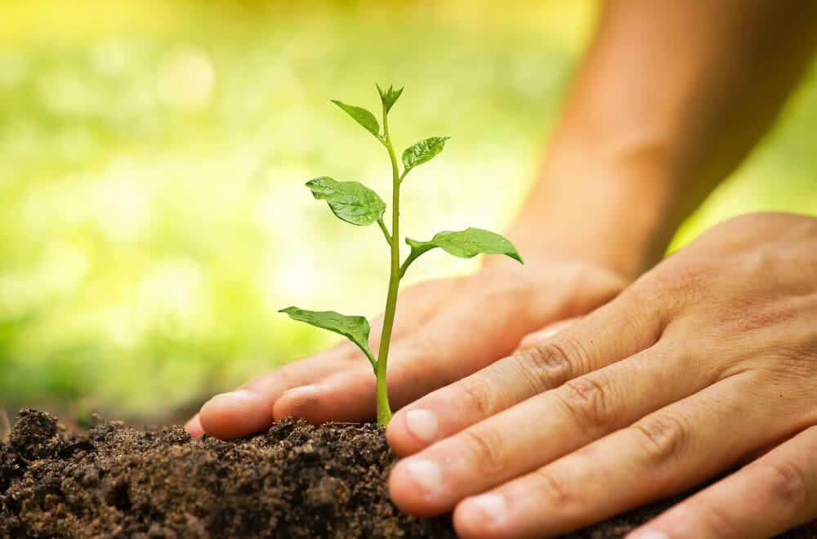
Plant a tree
Every year, the Earth loses billions of trees from deforestation. Trees are vital to our ecosystem as they help remove carbon dioxide from the atmosphere. Kids can help replenish trees by planting seeds of their choice in a local forest or park.

Slide 10
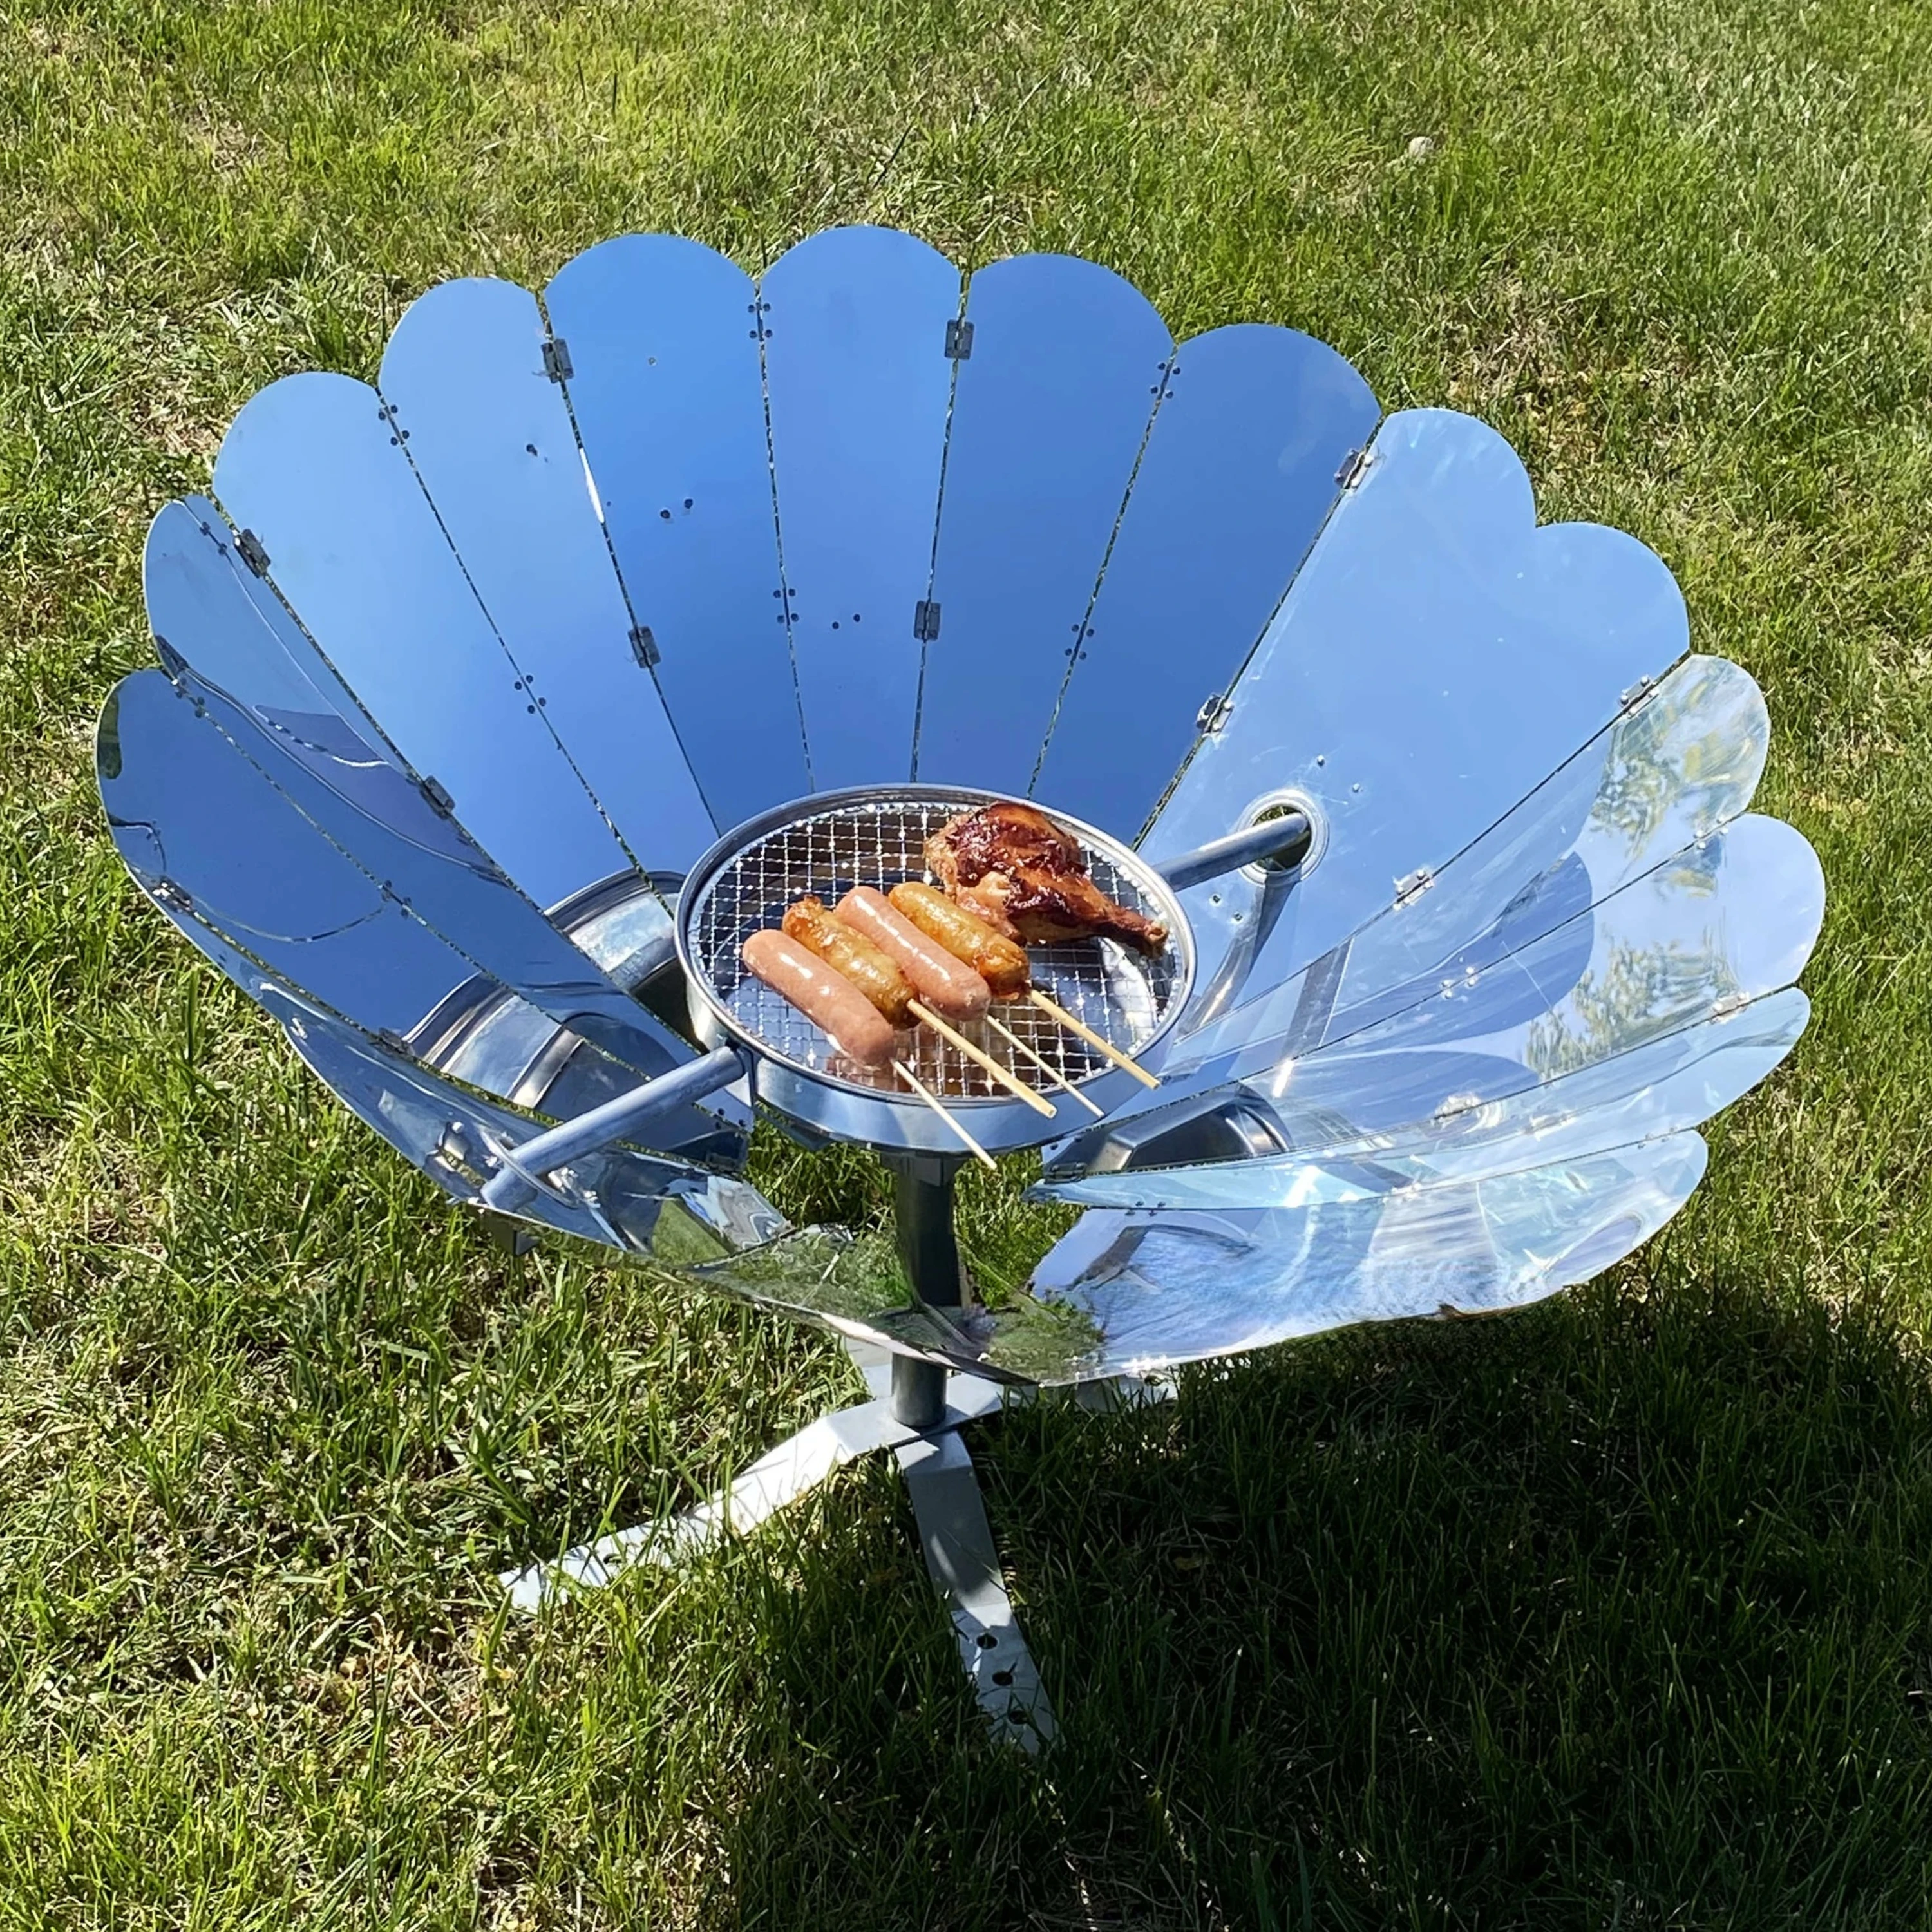
Build a
solar oven

Slide 11
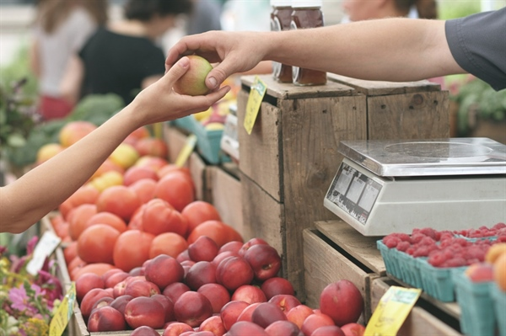
Go on a Local Shopping Trip
Sustainable shopping is buying local goods to support your local farmers and vendors in the community.

Slide 12
“Just A Dream” is an inspiring sustainability-themed book that young readers are sure to enjoy. The main character, Walter, doesn’t care about the planet’s health until he has a life-changing dream. In his dream, he sees natural resources being drained and air pollution at its worst, thus realizing his environmental responsibility toward the Earth.

Slide 13
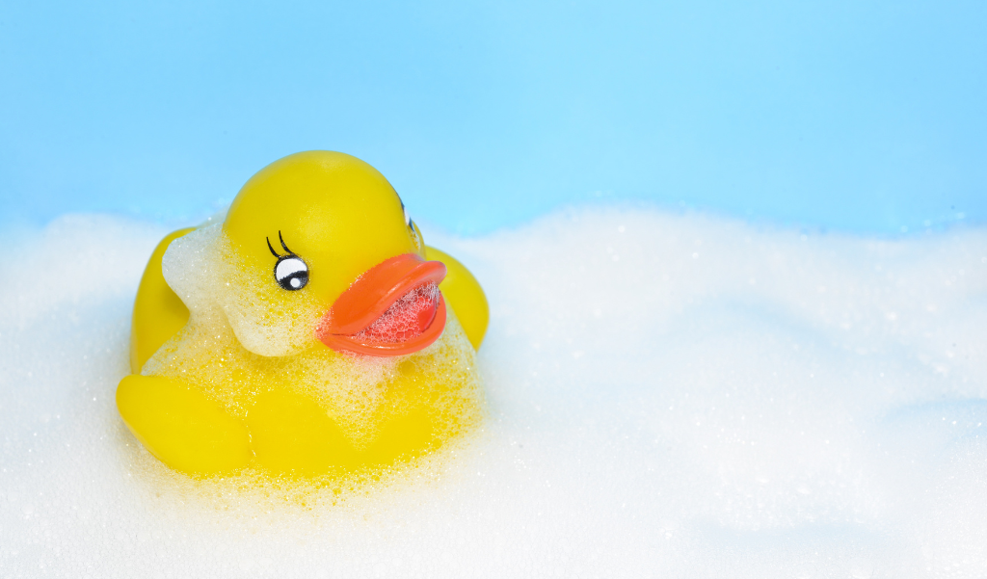
Say Bye Bye to Bath Time
Eventhough you might enjoy bath time, know that showers can save a lot of water

Slide 14
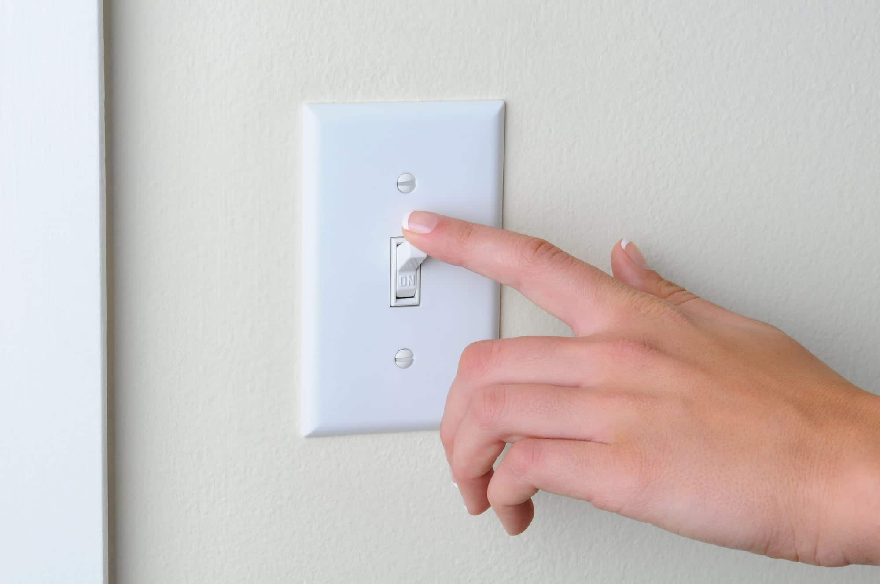
Have an Energy-Free Morning
No lights, no microwave, no electricity etc.for the entire morning!
We rely on electricity in our daily lives too much and we should try to save it when we can.

Slide 16
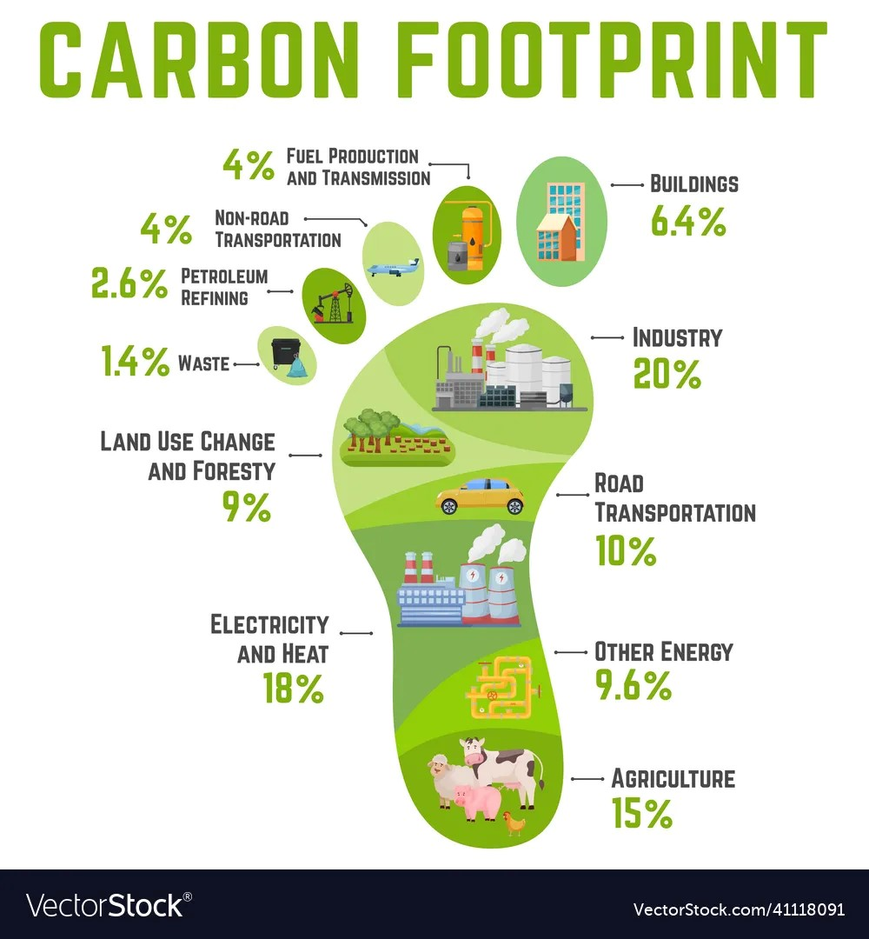
Carbon Footprint
A measure of the amount of carbon dioxide released into the atmosphere as a result of the activities of a particular individual, organization, or community.

Slide 17
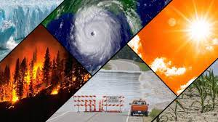
Climate change
A short video on CLIMATE CHANGE

Slide 18
Videoleap
How to use Videoleap

Slide 19
-Download the app -Open the app -Click X in the right hand corner

Slide 20
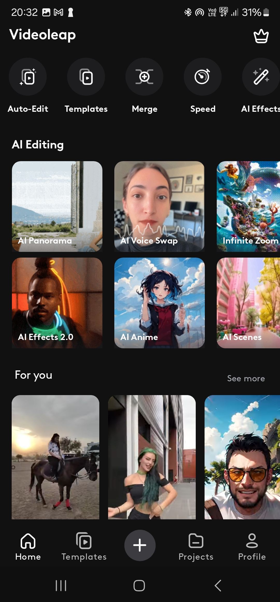
Starting a new project

Slide 21
Choose photoes, pictures…

Slide 22
This is your timeline You can add or remove items from it

Slide 23
Clicking on icons shows you when somwthing will appear

Slide 24
You can shorten or widen the video

Slide 25
You can record something or write text on the pictures

Slide 26
Good luck with your presentations!
You have about 45 minutes do finish them. Find around 15 things you can do to support our planet, describe and illustrate them
You have to use 10 photos of your own, so use you cameras to catch them
The title is
Sustainability activities we can do to support our
planet

